Slide 1
Mobile Radio Propagation: Small scale Fading and multipath

Slide 2
Small scale fading
Is used to describe the rapid fluctuation of the amplitude of a radio signal over a short period of time or travel distance, so that large-scale path loss effects may be ignored.
Fading is caused by interference between two or more versions of the transmitter signal which arrive at the receiver at slightly different times.
These are called Multipath waves.

Slide 3
Small scale fading…
Small scale multipath propagation causes the following small-scale fading effects;
Rapid changes in signal strength over a small travel distance or time interval.
Random frequency modulation due to varying doppler shifts on different multipath signals.
Time dispersion (echoes) caused by multipath propagation delays.

Slide 4
Small scale fading…
In built-up urban areas fading occurs because the height of the mobile antennas are well below the height of surrounding structures, so there is no single line-of-sight path to the base station.
If there is no Line-Of-Sight, multipath still occurs due to reflections from the ground and surrounding structures.
Incoming radio waves arrive from different directions with different propagation delays.
If objects are static in the radio channel, motion considered is only that of the mobile hence fading is purely a spatial phenomenon.

Slide 5
Factors influencing small scale fading
Multipath propagation
Occurs due to the presence of reflecting objects and scatterers.
2. Speed of the mobile
- Relative motion between base station and mobile results in random frequency modulation, due to different doppler shifts on each of the multipath components.

Slide 6
Factors influencing small scale fading…
3. Speed of surrounding objects
This movement induce a time varying doppler shift on multipath components. If surrounding objects move at a greater rate than the mobile, this effect dominates the small-scale fading.
4. Transmitted Bandwidth of the signal
- If transmitted radio signal bandwidth is greater than the bandwidth of the multipath channel, the received signal will be distorted.

Slide 7
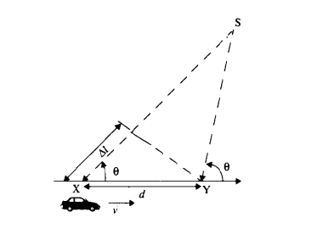
Doppler Shift

Slide 8

Doppler Shift

Slide 9
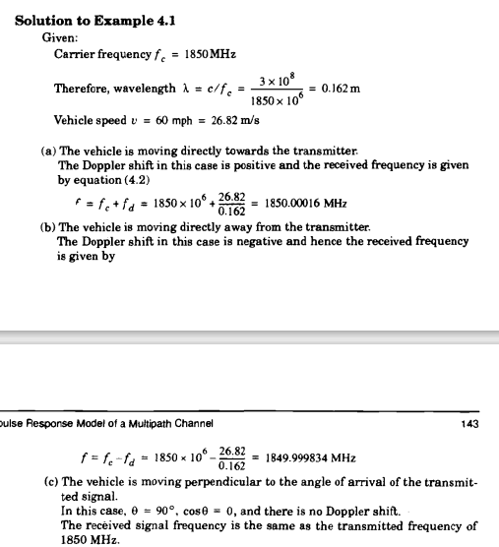
Doppler Shift

Slide 10
Impulse response model of a multipath channel
Small scale variations of a mobile radio signal is directly proportional to the impulse response of a mobile radio channel.
Impulse response- is a wide-band channel characterization and contains all information necessary to simulate or analyze any type of radio transmission through the channel.
This stems from the fact that a mobile channel may be modeled as a linear filter with a time varying impulse response.

Slide 11
Impulse response model of a multipath channel
Calculations

Slide 12
Small scale multipath measurements
Techniques of determining multipath structure
Direct pulse measurement
Spread spectrum sliding correlator measurements
Swept frequency measurements

Slide 13
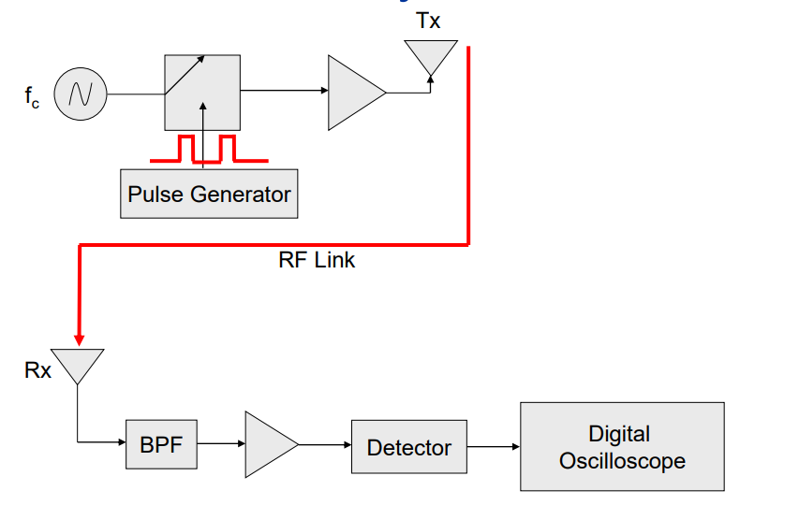
Direct RF pulse System
This is a simple channel sounding approach is the direct RF pulse system; this allows to determine rapidly the power delay profile of any channel.

Slide 14
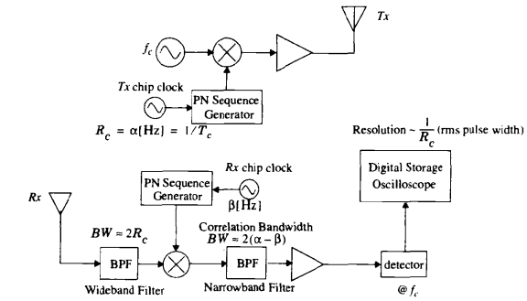
Spread spectrum Sliding correlator measurements
Here signal is spread over a large bandwidth by mixing it with a binary pseudo-noise (PN) sequence.

Slide 15
Parameters of Mobile Multipath Channels
Time dispersion parameter
Coherence bandwidth
Doppler spread and Coherence time
Notes:
In order to compare the different multipath channels and to develop some general design guidelines for wireless systems, parameters which grossly quantify the multipath channels are used.

Slide 16
Time dispersion parameters
Mean excess delay, RMS delay and Excess delay spread (X dB) are multipath channel parameters that can be determined from a power delay profile
The Mean excess delay is the first moment of the power delay profile and is defined to be,
Where a and τ are the real amplitudes and excess delays
The RMS delay spread is the square root of the second central moment of the power delay profile and is defined to be,
where
Notes:
Excess delay: is the relative delay of the i^{th} multipath component as compared to the first arriving component and is given by τ_{i}.
These delays are measured relative to the first detectable signal arriving at the receiver at τ₀ = 0
The RMS delay spread and Mean excess delay spread are defined from a single power delay profile which is the temporal or spatial average of consecutive impulse response measurements collected and averaged over a local area.
Typical values of rms delay spread are on the order of microseconds in outdoor moble channels and on the order of nanoseconds in indoor radio channels.
The maximum excess delay (X dB) of the power delay profile is defined to be the time delay during which multipath energy falls to X dB below the maximum. It also defines the temporal extent of the multipath that is above a particular threshold.
In practice, values for τ , τ², σ_{τ} depend on the choice of noise threshold used to process P(τ ).
The noise threshold is used to differentiate between received multipath components and thermal noise.
If the thermal noise is set low, then noise is processed as multipath, thus giving values that are artificially high.

Slide 17
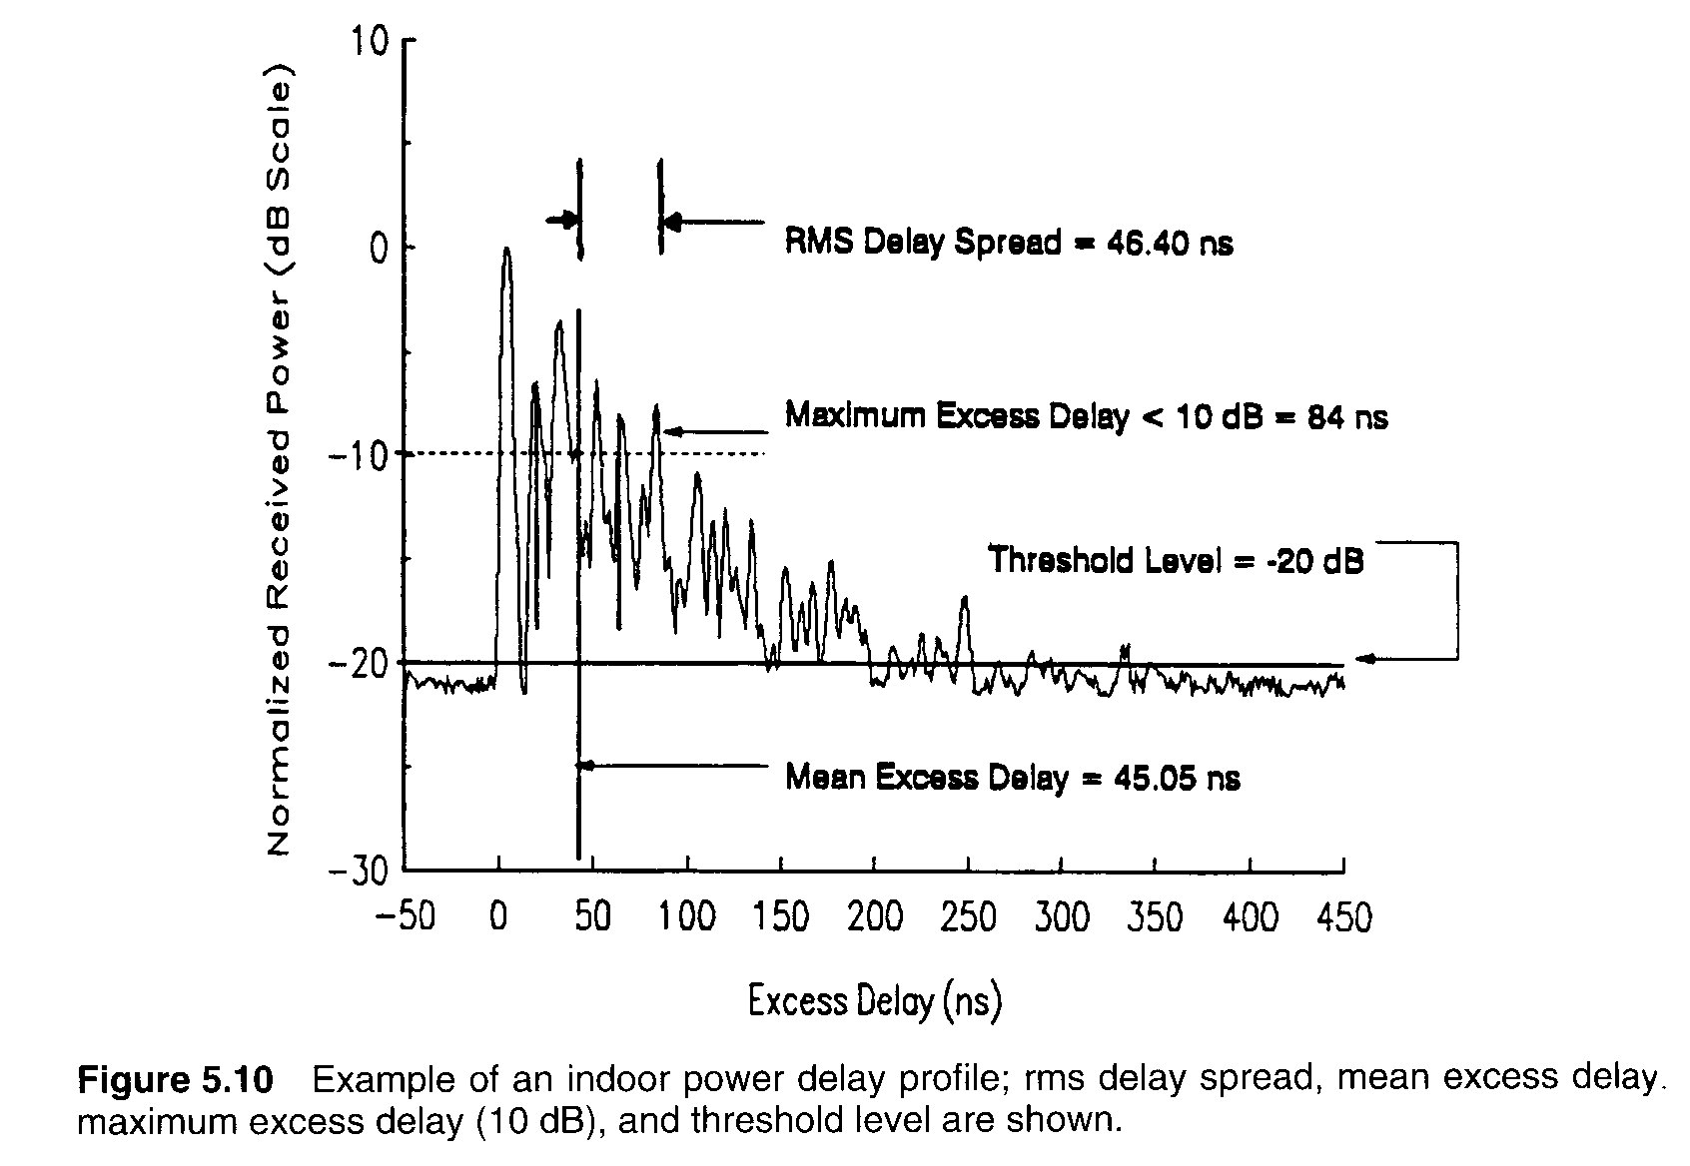

Slide 18
Coherence Bandwidth
Coherence bandwidth is a range of frequencies over which the channel can be considered “flat” I.e., a channel which passes all spectral components with approximately equal gain and linear phase.
I.e., it is the range of frequencies over which two frequency components have a strong potential for amplitude correlation
For Example: If the coherence bandwidth is defined as the bandwidth over which the frequency correlation function is above 0.9, then the coherence bandwidth is approximately,
B_{C} ≈ 1/ 50 σ_{τ}
If the definition is relaxed so that the frequency correlation function is above 0.5, then the coherence bandwidth is approximately,
B_{C} ≈ 1/ 5 σ_{τ}
Notes:
Analogous to the delay spread parameters in the time domain, coherence bandwidth is used to characterize the channel in the frequency domain
While the delay spread is a natural phenomenon caused by the reflected and scattered propagation paths in the radio channel, the coherence bandwidth, B_{C}, is a defined relation derived from the RMS delay spread

Slide 19
Doppler Spread & Coherence Time
Doppler spread B_{D} is a measure of the spectral broadening caused by the time rate change of the mobile radio channel and is defined as the range of frequencies over which the received Doppler spectrum is essentially non-zero.
Notes:
Delay spread and coherence bandwidth are the parameters which describe the time dispersive nature of the channel in a local area.
They do not offer information about the time varying nature of the channel caused by either relative motion between the mobile and base station or by the movements of the objects in the channel
Doppler spread and coherence time are the parameters which describe the time varying nature of the channel in a small - scale region
The amount of spectral broadening depends on f_{d} which is a function of the relative velocity of the mobile and the direction of arrival of the scattered waves.
Consider a pure sinusoidal tone of frequency f_{c} be transmitted, the received spectrum called the Doppler spectrum, will have components in the range of f_{c} - f_{d} to f_{c} + f_{d} , where f_{d} is the Doppler shift.
If the baseband signal bandwidth is much greater than B_{D}, the effects of Doppler spread are negligible at the receiver. This is a Slow fading channel.

Slide 20
Doppler Spread & Coherence Time (2)
Coherence time T_{C} is the time domain dual of Doppler spread and is used to characterize the time varying nature of the frequency dispersiveness of the channel in the time domain.
The Doppler spread and Coherence time are inversely proportional to one another, I.e., T_{C} ≈ 1 / f_{m} ➔ eq. (2)
Coherence time is actually a statistical measure of the time duration over which the channel impulse response is essentially invariant and quantifies the similarity of the channel response at different times.
Coherence time is the duration over which two received signals have a strong potential for amplitude correlation
If the reciprocal bandwidth of the baseband signal is greater than the coherence time of the channel, then the channel will change during the transmission of the baseband message, thus causing distortion at the receiver

Slide 21
Doppler Spread & Coherence Time (3)
If the coherence time is defined as the time over which the time correlation function is above 0.5, then the coherence time is approximately,
T_{C} ≈ 9 / 16Π f_{m} ➔ eq. (1)
Where f_{m} is the maximum Doppler shift given by, f_{m} = ν / λ
A popular thumb rule for modern digital communications is to define the coherence time as the geometric mean of the eq.(1) & (2). That is,
T_{C} = √ 9 / 16Π f_{m} = 0.423 / f_{m}

Slide 22
Small Scale Fading:
Different types of transmitted signals undergo different types of fading depending upon the relation between the
Signal Parameters: Bandwidth, Symbol Period
and
Channel Parameters: RMS Delay Spread,
Doppler Spread
In any mobile radio channel a wave can be dispersed either in Time or in Frequency.
These time and frequency dispersion mechanisms lead to four possible distinct effects which depend on the nature of transmitted signal, the channel and the velocity.
Notes:
Topics:
Small – Scale Fading:
Fading Effects due to Multipath Time Delay
Fading Effects due to Doppler Spread
Rayleigh and Ricean Distributions
Large Scale Fading :
This is the loss that propagation models try to account for mostly dependant on the distance from the transmitter to the receiver also known as Large Scale Path Loss, Log-Normal Fading or Shadowing
Small Scale Fading :
Could be 20-30 dB over a fraction of a wavelength.It is caused by the superposition or cancellation of multipath propagation signals, the speed of the transmitter or receiver or the bandwidth of the transmitted signal.It is also known as Multipath Fading or Rayleigh Fading

Slide 23
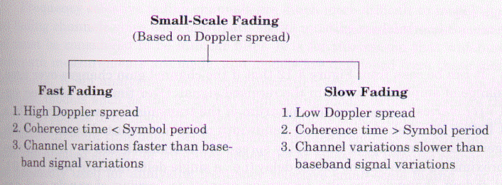
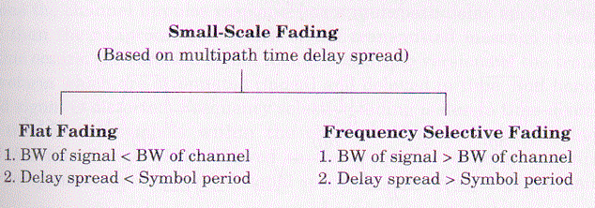

Slide 24
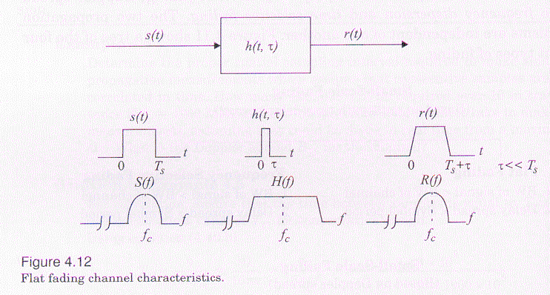
Flat Fading:
A received signal is said to have underwent Flat Fading if “The Mobile Radio Channel has a constant gain and linear phase response over a Bandwidth which is greater than the Bandwidth of the transmitted Signal”
Notes:
B_{s}<< B_{c}
From the figure we can note that if the channel gain varies with time, a change of amplitude of the received signal occurs.
From the figure we can note that the spectrum of the received signal r(t) is preserved even though there is a change in gain.
Flat fading channels are also referred as amplitude varying channels or narrow band channels, since the bandwidth of the applied signal is narrow as compared to the channel flat fading bandwidth.
Typical Flat fading channels cause deep fades
To achieve low bit error rates during times of deep fades, Flat fading channels operate at 20 to 30dB more transmitter power compared to the systems operating over non-fading channels.
For designing Radio links, the distribution of the instantaneous gain of flat fading channels is important.
Rayleigh distribution is the most common amplitude distribution.
According to this distribution, Rayleigh Flat fading channel model assumes that the channel induces an amplitude which varies in time.
Signal undergoes Flat Fading if:
B_{s}<<B_{c}
where
B_{s} is bandwidth and
B_{c} is the coherence bandwidth of the channel
And
T_{s}>>σ_{τ} where
T_{s} is the reciprocal bandwidth and
σ_{τ} rms delay spread.

Slide 25
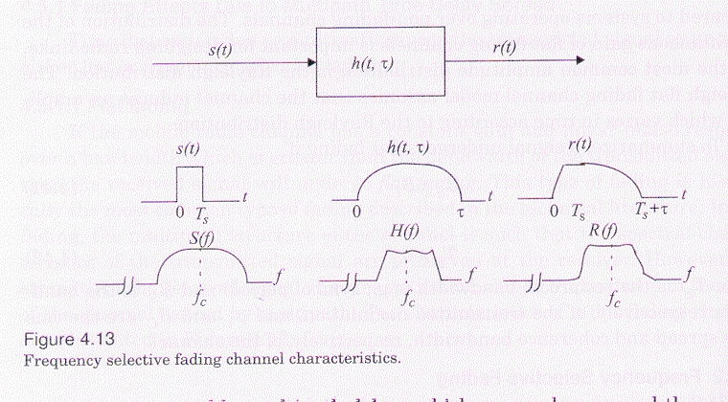
Frequency Selective Fading:
The channel creates frequency selective fading on the received signal when the channel possesses a constant gain and linear phase response over a bandwidth, which is smaller than the bandwidth of the transmitted signal
Notes:
Under these conditions the channel impulse response has a multipath delay spread which is greater than the reciprocal bandwidth of the transmitted message waveform
So the received signal includes multiple versions of the transmitted waveform, which are attenuated and delayed in time, and hence the received signal is distorted.
Frequency selective fading is much difficult to model than flat fading channels because each multipath signal must be modeled and the channel must be considered to be a linear filter
It is for this reason that wideband multipath measurements are made and models are developed from these measurements
When analyzing mobile communication systems, statistical impulse response models such as the 2-ray Rayleigh model or computer generated or measured impulse responses are generally used for analyzing frequency selective small-scale fading.
For frequency selective fading, the spectrum S(f) of the transmitted signal has a bandwidth which is greater than the coherence bandwidth B_{c} of the channel
Frequency selective fading is caused by multipath delays which approach or exceed the symbol period of the transmitted symbol
These channels are also known as wideband channels since the bandwidth of the signal s(t) is wider than the bandwidth of the channel impulse response
As time varies, the channel varies in gain and phase across the spectrum of s(t),resulting in time varying distortion in the received signal r(t)
Summary
Signal undergoes Frequency Selective Fading if:
B_{s}>B_{c}
B_{s} is bandwidth and
B_{c} is the coherence bandwidth of the channel
T_{s}<σ_{τ} T_{s} is the reciprocal bandwidth and
σ_{τ} rms delay spread.

Slide 26
Fast Fading:
In Fast Fading channel, the channel impulse response changes at a rate much faster than the transmitted baseband signal. This causes frequency dispersion due to Doppler spreading, which leads to signal distortion
Hence a signal will undergo fast fading if
and
Note: Fast fading only deals with the rate of change of the channel due to motion. fast fading occurs only for very low data rates.
Notes:
Fading Effects Due to Doppler Spread:
Channels are also classified depending upon how rapidly the transmitted baseband signal changes compared to the rate of change of channel.
It is either Fast Fading or Slow Fading channel.
The velocity of the mobile (or the velocity of the objects in the channels) and the baseband signaling determines whether a signal undergoes fast or slow fading.
In Fast Fading channel, the channel impulse response changes at a rate much faster than the transmitted baseband signal.
In other words the coherence time of the channel is smaller than the symbol period of the transmitted signal.
This causes frequency dispersion due to Doppler spreading, which leads to signal distortion.
When viewed in frequency domain, signal distortion due to fast fading increases with increasing Doppler spread relative to the bandwidth of the transmitted signal.
When a channel is specified as Fast or Slow fading channel, it does not specify whether the channel is flat fading or frequency selective in nature
In the case of flat fading channel, we can approximate the impulse response to be a delta function without the time delay.
Hence, a flat fading, fast fading channel is a channel in which the amplitude of the delta function varies faster than the rate of change of the baseband transmitted signal
A frequency selective, fast fading channel, the amplitudes, phases, and the time delays of any one of the multipath components vary faster than the rate of change of transmitted signal

Slide 27
Slow Fading
In Slow Fading channel the channel impulse response changes at a rate much slower than the transmitted baseband signal.
Hence a signal will undergo slow fading if
and
Note: Fast and Slow Fading deal with the relationship between the time rate of change in the channel and the transmitted signal, and not with the propagation path loss models.
Notes:
In Slow Fading channel the channel impulse response changes at a rate much slower than the transmitted baseband signal
Here the channel may be assumed static over one or several bandwidth intervals.
In the frequency domain, this implies that the Doppler spread of the channel is much less than the bandwidth of the baseband channel.
The velocity of the mobile and the baseband signaling determine whether a signal undergoes fast fading or slow fading.

Slide 28
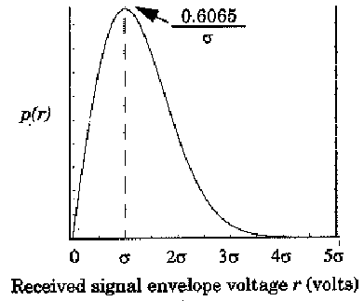
Rayleigh Fading Distribution:
Rayleigh Fading Distribution in mobile radio channels is commonly used to describe the statistical time varying nature of the received envelope of a flat fading signal or the envelope of an individual multipath component.
The pdf of a Rayleigh distribution:
0 (r < 0)
CDF
Notes:
where
σ is the rms value of the received voltage signal before envelope detection,
σ² is the time-average power of the received signal before envelope detection.
The probability that the envelope of the received signal does not exceed a specified value R is given by the corresponding cumulative distribution function(CDF)

Slide 29
The mean value of the Rayleigh distribution is given by
The variance of the Rayleigh distribution is given by
The rms value of the envelope is
The median value of r is found by solving
Notes:
which represents the ac power in the signal envelope.
It is customary to use median values instead of the mean values, since fading data are usually measured in the field and a particular distribution cannot be assumed.
• By using median values instead of mean values it is easier to compare different fading distributions which have widely varying means

Slide 30
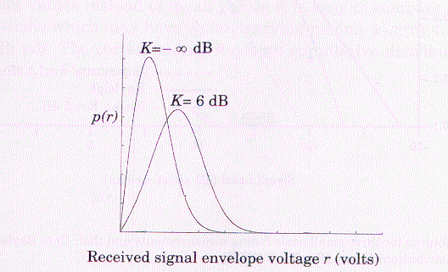
Ricean Fading Distribution:
When there is a dominant stationary (nonfading) signal component present, such as a line-of-sight propagation path, the small scale-scale fading envelope distribution is Ricean.
The Ricean distribution is often defined in terms of a parameter K called the Ricean Factor
Notes:
Random multipath components arriving at different angles are superimposed on a stationary dominant signal
At the output of an envelope detector this has the effect of adding a dc component to the random multipath
The effect of a dominant signal arriving with many weaker multipath signals gives rise to Ricean distribution
As the dominant signal becomes weaker, the composite signal gives resembles a noise signal which has an envelope that is Rayleigh
Ricean Factor K completes determines the Ricean distribution.
As A→ 0, K →- ∞ dB, and as the dominant path decreases in amplitude, the Ricean distribution degenerates to Rayleigh distribution
Thus, the Ricean distribution degenerates to a Rayleigh distribution when the dominant component fades away
Where K is defined as the ratio between the deterministic signal power and the variance of the multipath.

Slide 31
Statistical Models for Multipath Fading Channels
Clarke’s Model for Flat Fading
Two-ray Rayleigh Fading Model
Saleh and Valenzuela Indoor Statistical Model
SIRCIM and SMRCIM Indoor and Outdoor Statistical Models
Level Crossing and Fading Statistics

